Slide 1

CC-215 Database Systems
— Unit 12 — Transaction Processing
Some slides and/or pictures are adapted from Lecture slides / Books of
Peter Rob
Jeffery. A. Hoffer
Thomas M. Connolly
Ramez Elmasri
Silberschtaz
Dr. Asif Sohail University of the Punjab Department of Information Technology, FCIT

Slide 2
Transaction Processing
A transaction is a logical unit of work on the database.
A transaction may be an entire program, a portion of a program or even a single statement.
A transaction brings the database from one consistent (correct/acceptable) state to another consistent state.
Consistent state is one in which all data integrity constraints are satisfied.
All transactions are controlled and executed by the DBMS to guarantee database integrity.
While a transaction is in progress, the database may temporarily be in some inconsistent state.

Slide 3
Transaction Examples
Example1: Banking transaction involving two relations:
ACC_TRANS(Acc_No, Amount, Date, Deposit/Withdraw, …)
ACC_BAL(Acc-No, Balance,…)
Against every insertion in ACC_TRANS, the ACC_BAL must be updated appropriately, otherwise the database will be in some inconsistent or wrong state.
Example2: Register credit sale of 100 units of product X to customer Y for $500
Reduce product X’s quantity by 100
Adding $500 to customer Y’s account receivable
UPDATE PRODUCT SET PROD_QTY = PROD_QTY - 100 WHERE PROD_CODE = ‘X’;
UPDATE ACCT_RECEIVABLE
SET ACCT_BALANCE = ACCT_BALANCE + 500 WHERE ACCT_NUM = ‘Y’;

Slide 4
Transaction Steps
A simple UPDATE on
"credits" field of a record
involves the following steps:
Locate the page containing
the appropriate record on disk.
Bringing the page into the
database buffer.
Rewriting the value of the
"credits" field in the record
in the buffer.
Finally writing the updated page
out to disk.
A complex transaction
involves multiple DML ops.
on multiple table(s) resulting
in a temporary inconsistent state.

Slide 5
Transaction Processing
There can be one of two possible outcomes of a transaction:
Committed: A successful completion of a transaction will bring the database into a new consistent state.
Aborted: An incomplete transaction will leave the database in some inconsistent state.
From 1 & 2, it can be concluded that a transaction must be entirely completed or entirely aborted.
An aborted transaction must be undone or rolled backed to keep the database in some consistent state.
A system component called Transaction Manager or Recovery Manager supports the above feature.
Statements for transaction processing include COMMIT, ROLLBACK, and SVEPOINT.

Slide 6
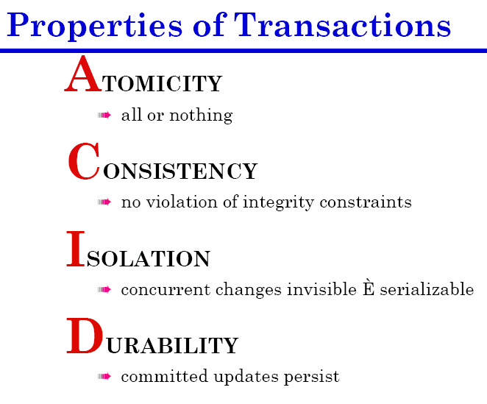

Slide 7
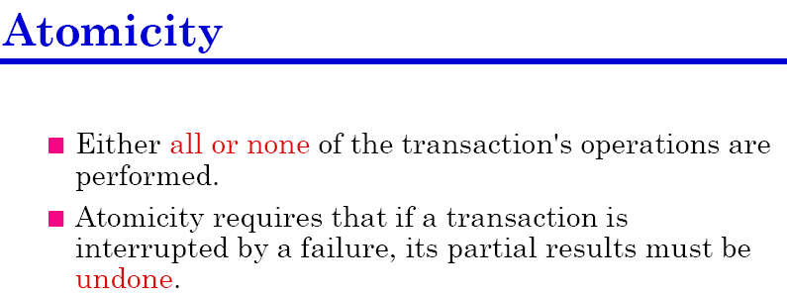
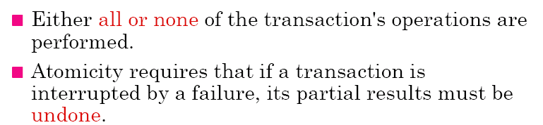

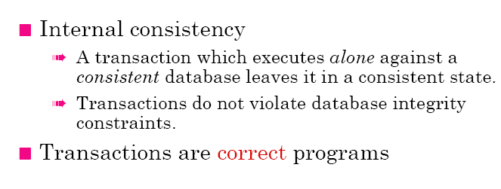
Transaction Properties
7

Slide 8
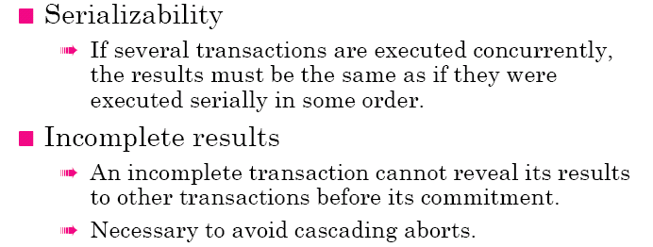
Transaction Properties

Slide 9
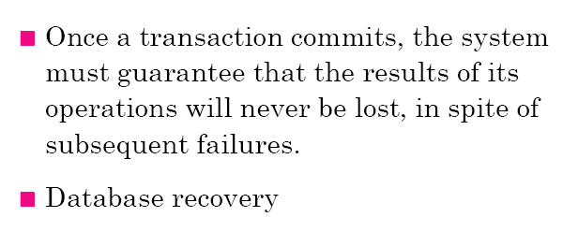
Transaction Properties

Slide 10
Transaction Properties
The following transaction transfers funds from account A to account B. Let the values of account A and B are 1000$ and 2000$ respectively.
read(A);
A := A − 50;
write(A);
read(B);
B := B + 50;
write(B).
While a transaction is in progress, the database may temporarily be in some inconsistent state.
Suppose that failure occurred after write(A). It will leave the system in inconsistent state permanently unless some corrective measures are taken.
Atomicity disallows the aforementioned scenario.
Consistency: Sum of A and B remains unchanged.
Isolation: Even if the consistency and atomicity properties are ensured for each transaction, if several transactions are executed concurrently, their operations may interleave in some undesirable way, resulting in an inconsistent state.
Durability: Once, COMMIT is issued in the transaction, the updates in the accounts will sustain, in spite of subsequent failures.

Slide 11
Transaction Management
Database

Slide 12
Buffer Management
An DML operation can be regarded as permanent only after the contents of memory buffer are flushed to secondary storage.
There might be a delay between the commit and the actual disk writing. Because updates made to buffer pages are not immediately written to disk. If there is a system failure during this delay, the system must be able to ensure that these updates reach the disk copy of the database.
The flushing of the buffers to the database can be triggered by a specific command (COMMIT) or automatically when the buffers become full. The explicit writing of the buffers to secondary storage is known as force-writing.
For efficient buffer management, Present / absent bit, Dirty bit, and Page replacement algorithms are employed.

Slide 13
Database Recovery
Database recovery is a process of restoring a database from a given state, usually inconsistent, to some consistent (correct) state in the event of a failure.
The recovery manager of a DBMS is responsible for ensuring two important properties of a transaction: Atomicity and Durability.
It ensures atomicity by undoing the actions of transactions that do not commit (Roll Backward or Undo)
It ensure durability by making sure that all actions of committed transactions survive even if the system crashes (Roll Forward or Redo).
There are the following database recovery techniques:
Backup mechanism
Logging facility
Checkpoint facility

Slide 14
Database Recovery Techniques
1. Backup Mechanism:
An Automatic dump facility that produces a backup copy of the entire database.
The backup copy is used to restore the database in the event of data loss or damage.
Full Backup
Differential Backup: Only the last modifications to the database (when compared with a previous backup copy).
After recovering the database up to the backup copy, further recovery is made using transaction logs.

Slide 15
Database Recovery Techniques
2. Logging facility:
It is also called trail or journal.
It maintains history of actions executed by the DBMS.
Logs are used to protect against system failures.
Two types of logs are used for database recovery.
a) Transaction Log
b) Database Change Log
Transaction Log stores the information like Transaction Code, Time, Terminal, User, input data values, records accessed and modified.
Database Change Log contains before images and after images of records that have been modified by transactions.
Protocols used for maintaining Database Change Log are:
a) Deferred Update Protocol
b) Immediate Update Protocol

Slide 16
Database Recovery Techniques
2. Logging facility:
Owing to the importance of log, two or more copies of the log on different disks or different locations of the same disk are maintained.
The most recent portion of the log, called log tail is kept in main memory and periodically flushed to stable storage.
Every log record is assigned a unique id called Log Sequence Number (LSN).
A log record is written for each command such as insert, update, delete, undo, commit, savepoint etc.

Slide 17
Recovery Techniques
a) Deferred Update Protocol
The DBMS records all database writes in the log, and does not write to the database until the transaction is ready to commit.
Any transaction with log records <T starts> and <T commits> should be redone in the order in which they appear in the log.
The transaction itself does not have to be executed again.
Transaction T Transaction Log & Data items

Slide 18
Recovery Techniques
b) Immediate Update Protocol
In this scheme, updates are applied to the database buffers as they occur and are written to the database itself.
Log Records are written before the transaction is actually committed and it contains both old and updated values.
This is also known as Write Ahead Log Protocol.

Slide 19
Deferred Update Protocol | Immediate Update Protocol
<T starts> | <T starts>
When any write operation is performed, do not actually write the update to the database buffers or the database itself. Instead, write a log record of the form <T,x,n>, showing the new value for X. | When a write operation is performed, write a log record containing of the form <T,x,o,n>, showing the old and new value for X.
<T commits>, write all the log records for the transaction to disk, and then commit the transaction. Use the log records to perform the actual updates to the database. | After the log record is written, write the update to the database buffers. Write the log records to disk and then write updates to the database itself. <T commits>
If the transaction aborts, simply ignore the log records for the transaction and do not perform the writes. | If a transaction aborts, the log can be used to undo it.
redo/no undo method, since we redo committed transactions and we do not undo any transactions. | redo/undo method, since we redo committed transactions and undo other transactions.

Slide 20
Database Recovery Facilities
DBMS
Database
(Current)
Transaction
Log
Database
Change Log
Database
(Backup)

Slide 21
Database Recovery Methods
There are the following database recovery techniques:
Restore / Rerun
Forward Recovery
Backward Recovery
A particular recovery method to be used depends on the extent of the damage that has occurred to the database.
If the database has been extensively damaged, for example a disk head crash has occurred and destroyed the database, then Restore/Rerun technique is used.
If the database has not been physically damaged but has become inconsistent, then either forward recovery or backward recovery is used.

Slide 22
Database Recovery Methods
1. Restore / Rerun
It involves reprocessing the transaction up to the point of failure against the backup copy of to the database.
The most recent backup copy of the database is mounted and all transactions(stored on transaction log) that have occurred since the copy are rerun.

Slide 23
Database Recovery Methods
2. Backward Recovery (Roll Backward)
It is also called immediate update recovery protocol.
Updates are applied to the database as they occur without waiting to reach a COMMIT point.
If a transaction fails before it reaches this point, we need to undo the changes.
It is used to undo unwanted changes to the database.
Before images of the records that have been changed are applied to the database.
As a result, the database is returned to an earlier state and the unwanted changes are eliminated.
This is shown in the Fig:

Slide 24
Database Recovery Methods
2. Backward Recovery (Roll Backward)
Database
(With
Changes)
Database
(Without
Changes)
DBMS
Before
Images

Slide 25
Database Recovery Methods
3. Forward Recovery (Roll Forward)
It is also called deferred update recovery protocol.
Updates are deferred and not written to the database immediately until after a transaction has reached its COMMIT point.
If a transaction fails before it reaches this point, it would not have modified the database and so no undoing of changes will be necessary. However, it may be necessary to redo the updates of committed transactions.
It is used to redo the changes that could not be stored to the database because of some failure during a transaction.
After images of the records that could not be changed are applied to the database.
As a result, the database is forwarded to a later state.
This is shown in the Fig:

Slide 26
Database Recovery Methods
3. Forward Recovery (Roll Forward)
Database
(Without
Changes)
Database
(With
Changes)
DBMS
After
Images

Slide 27
Database Recovery Methods
When to use Roll Backward and When to use Roll Forward?
Which Transaction to undo and which to redo?

Slide 28
Checkpointing
A difficulty in recovering from log file is that when a failure occurs, we may not know how far back in the log to search.
The DBMS records checkpoints (at certain prescribed intervals) to the log file whenever it writes all of its updated buffers to the disk. Checkpoints are used to synchronize the log file.
A DBMS may perform checkpoints automatically or in response to commands in user application programs.
When failures do occur, the recovery is resumed from the most recent checkpoint.

Slide 29
Checkpointing
All transactions T, for which both <T Starts> and <T Commit> appear in the log are redone.
For transactions S, for which the log contains <S Starts> but not <S Commit> will be undone.
T_{c} T_{f}
Time
T1
T2
T3
T4
T5
In the given Fig., transactions T3 and T5 must be undone and transactions T2 and T4 must be redone.
At restart, the system goes through the following procedure:

Slide 30
Checkpointing
T_{c} T_{f}
Time
T1
T2
T3
T4
T5
It starts with two lists of transactions, UNDO list and REDO list.
UNDO list is set to all transactions recorded at the time of checkpoint T_{c}, whereas REDO list is set to empty.
Log is searched starting from the checkpoint T_{c}.
If <T Starts> for a transaction T is found in the log, add it to UNDO list.
It <T Commit> for a transaction T is found, move T from UNDO list to REDO list.
Upon the end of log, the UNDO and REDO lists are identified.

Slide 31
Shadow Paging
Shadow paging is an alternative to log-based recovery techniques. It employs two page tables; a current page table and a shadow page table.
All modifications are made to the current page table, and the shadow table is left unchanged.
When a transaction needs to make a change to a database page, the system finds an unused page on disk, copies the old database page to the new one, and makes changes to the new page. It also updates the current page table to point to the new page.
If the transaction completes successfully, the current page table is retained. Otherwise, the new pages are ignored, and the shadow page table becomes the current page table.

Slide 32
Reasons of Database Failure
System Failure
Database Destruction (Media Failure)
Application software errors
Incorrect data
Natural physical disasters
Sabotage

Slide 33
Reasons of Database Failure
1. System Failure
It affects all transactions currently in progress but does not physically damage the database.
It is also known as soft crash.
Some causes of system failure are power loss, system software failure etc.
System failure can be recovered using Roll Forward and Roll Backward.
2. Database Destruction
Database itself is lost or destroyed.
It is also known as Hard Crash.
A Backup copy of the database is required for recovery in this situation.

Slide 34
Reasons of Database Failure
3. Application software errors
Logical errors in a program that cause one or more transactions to fail.
4. Incorrect Data
Database updated with an incorrect data may initiate a chain to erroneous transactions leading to database failure.
In such situation, the database can be recovered using:
Backward Recovery
Applying a series of compensating transactions to nullify the effect of incorrect input.

Slide 35
Reading Material
Database Systems – Design, Implementation and Management: Carlos Coronel, Steven Morris (13th Ed.)
Modern Database Management: Jeffery. A. Hoffer (12th Ed.)
Database Systems: Thomas M. Connolly (6th Ed.)
Fundamentals of Database Systems: Elmasri (7th Ed.)
Database System Concepts: Abraham Silberschatz (7th Ed.)
Databases Illuminated: Catherine M. Ricardo (3rd Ed.)
Book | Section(s) / Chapter
A | 10.1, 10.7
B | None
C | 22.1, 22.3
D | 20.1 to 20.3
E | 17.1 to 17.5
F | 9.1, 9.7 to 9.9

